Slide 1
Smart Home Energy Management System
SWETHA PALLEY

Slide 2
What is SHEMS?
A modern, technology-driven solution designed to efficiently monitor, control, and optimize electrical energy consumption within a smart home.
Key Capabilities:
Tracks real-time energy usage.
Reduces energy wastage and improves convenience.
Uses network-connected devices, automation rules, and analytics.

Slide 3
Proposed Solution
Key Features of the Proposed System:
Centralized Control: Unified management of all smart devices.
Real-Time Monitoring: Live tracking of energy consumption.
Automated Scheduling: Automatic device control based on preset schedules.
Analytics Dashboard: Visual insights into consumption patterns.
Enhanced Security: Secured access using Authentication and Role-Based Authorization.

Slide 4
System Configuration (Tech Stack)
Backend Technologies:
Language: Java 21
Frameworks: Spring Boot, Spring MVC
Security: Spring Security (JWT Authorization)
ORM: Hibernate/JPA (No manual SQL queries)
API: RESTful Web Services
Frontend Technologies:
HTML5 & CSS
ReactJS
Database & Tools:
MySQL Database & MySQL Workbench
IntelliJ IDEA Community Edition
Postman (API Testing) & GitHub (Version Control)

Slide 5
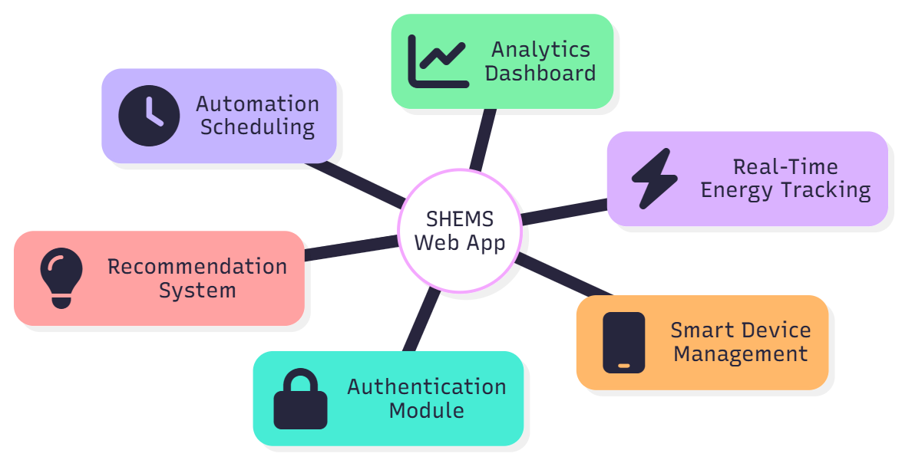
Project Modules
Authentication & Role Management: Secure login, registration, and role-based access.
Smart Device Management: Adding, updating, and removing devices; status control.
Real-Time Energy Tracking: Live monitoring of energy for each device.
Analytics Dashboard: Charts and graphs showing peak hours and consumption trends.
Automation Scheduling: Automatic ON/OFF control based on rules.
Recommendation System: Smart suggestions to optimize usage .

Slide 6
Module 1 - Authentication & Role Management
Objective: To provide a secure entry point for the application using encryption and token-based authorization.
Key Activities:
User Registration & Login.
Password Encryption.
JWT (JSON Web Token) generation and validation.
Role-based screen access (Admin vs. User).

Slide 7
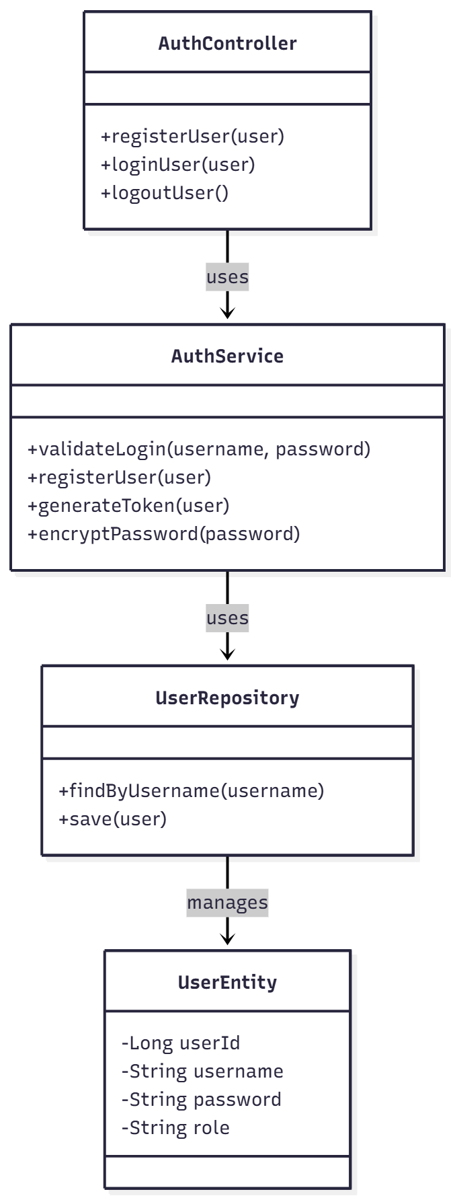
Module 1 - Technical Implementation (Classes)
User (Entity Class):
  Stores user profile details (username, password, name).
  Contains role information used for authorization.
AuthController:
  Exposes REST APIs for login and registration.
  Acts as the bridge between the Frontend and the Backend Service layer.
AuthService:
  Handles core business logic.
  Validates login credentials and encrypts passwords.
  Generates and validates JWT tokens.
UserRepository:
  Communicates directly with the MySQL database using JPA.
  Methods include finding users by username and saving records.

Slide 8
MODULE 2 - Smart Device Management
Primary Goal: To digitize physical appliances into manageable software entities.
Key Features:
Device Registration: Users can add devices (e.g., "Living Room AC").
Status Toggling: Switch devices ON or OFF remotely.
Attribute Management: Update power ratings (Wattage) and location.
Inventory List: View all connected devices in a grid layout.

Slide 9
Module 2 - Workflow
Scenario: User adds a new device.
Start: User clicks "Add Device" on Dashboard.
Input: User enters Details (Name: "Fan", Watts: "75W", Room: "Bedroom").
Validation: Frontend checks for empty fields; Backend checks if device limit is reached.
Processing: DeviceService maps the device to the current User ID.
Database: DeviceRepository saves the entry to the DEVICES table.
End: Device appears on the User Dashboard.

Slide 10
Module 2 - Technical Implementation (Classes)
The module consists of four primary classes:
  Device (Model): Represents the data structure/entity.
  DeviceController: The API entry point.
  DeviceService: The logic layer.
  DeviceRepository: The database interface.

Slide 11
Class: Device
Attributes:
Long deviceId (Unique Identifier)
String deviceName (e.g., "Smart Bulb 1")
String deviceType (Categorization)
String status (Current state)
String location (Physical placement)
String ipAddress (Network ID)
String config (Settings)

Slide 12
DEVICE CONTROLLER
Class: DeviceController
Role: The API Layer (REST Controller).
Responsibilities:
Exposes endpoints to the frontend.
Receives user requests.
Does not have a database table.
Key Endpoints:
/addDevice – To register a new appliance.
/toggleDevice – To switch an appliance ON or OFF.

Slide 13
DEVICE SERVICE
Class: DeviceService
Role: The Service Layer.
Responsibilities:
Contains business logic and rules.
Acts as a bridge between the Controller and Repository.
Does not have a database table.
Key Methods:
addDevice()
updateStatus()

Slide 14
DEVICEREPOSITRY
Class: DeviceRepository
Role: Data Access Object (DAO).
Responsibilities:
Performs SQL operations on the devices table.
Abstracts the database connection.
Key Methods:
save(Device) – Inserts or updates a record.
findAll() – Retrieves all device records.

Slide 15
Outputs & Deliverables
System Outputs:
Real-time device status updates (e.g., notifying the dashboard when a light turns on).
A comprehensive device list for the frontend dashboard.
Conclusion:
Module 2 successfully establishes the backend infrastructure to track and control smart home assets, serving as the foundation for the Energy Management System.

Slide 16
Module 3: Real-Time Energy Tracking
Real-Time Energy Tracking Module
Monitors live electricity consumption of all smart devices
Collects data continuously from connected IoT sensors
Displays current power usage in watts (W) and units (kWh)
Enables users to understand energy usage instantly
Forms the foundation for analytics and optimization

Slide 17
Key Features
Core Functionalities
Live device-level energy monitoring
Instant ON/OFF status tracking
Automatic meter data updates
Historical energy logging
Alerts for abnormal or excessive consumption

Slide 18
Working Process / Architecture
Tech Stack Used
Spring Boot
REST APIs
MySQL
WebSocket/AJAX for live updates
How It Works
Smart devices send readings via IoT sensors
Backend (Spring Boot) collects data through REST APIs
Data stored in MySQL database
Real-time updates pushed to frontend
Dashboard displays live consumption graphs

Slide 19
Benefits & Outcomes
Helps reduce electricity bills
Detects energy wastage instantly
Improves device efficiency
Enables quick decision-making
Supports future automation & scheduling

Slide 20
Module 4: Analytics Dashboard
Analytics Dashboard Module
Visualizes energy consumption data
Converts raw data into meaningful insights
Shows trends, patterns, and comparisons
Helps users optimize power usage
Central control panel for monitoring system

Slide 21
Dashboard Features
Main Components
Daily / Weekly / Monthly usage charts
Device-wise consumption breakdown
Peak usage time analysis
Cost estimation reports
Role-based dashboard views (Owner / Guest / Child)

Slide 22
Visualizations & Reports
Data Representation
Bar charts for device comparison
Line graphs for usage trends
Pie charts for energy distribution
Tables for detailed statistics
Export reports (PDF/CSV)
Purpose: Easy interpretation of large datasets

Slide 23
Benefits & Business Value
Impact
Identifies high-consumption devices
Enables smart energy planning
Reduces operational costs
Improves sustainability
Enhances user experience with clear insights

Slide 24
Thank you

